Slide 1

Ethical Principles For Medical Research Involving Human Subjects
By:
Jalal Poorolajal, MD, MPH, PhD
Department of Epidemiology, School of Public Health

Slide 2
Topics
History
Ethical Considerations

Slide 3
Nazi Human Experiments
Bone, muscle, and nerve transplantation experiments
Experiments on twins
Blood coagulation experiments
Sterilization and fertility experiments
Malaria experiments
Immunization experiments
Freezing experiments
Mustard gas experiments
Experiments with poison
Incendiary bomb experiments

Slide 4
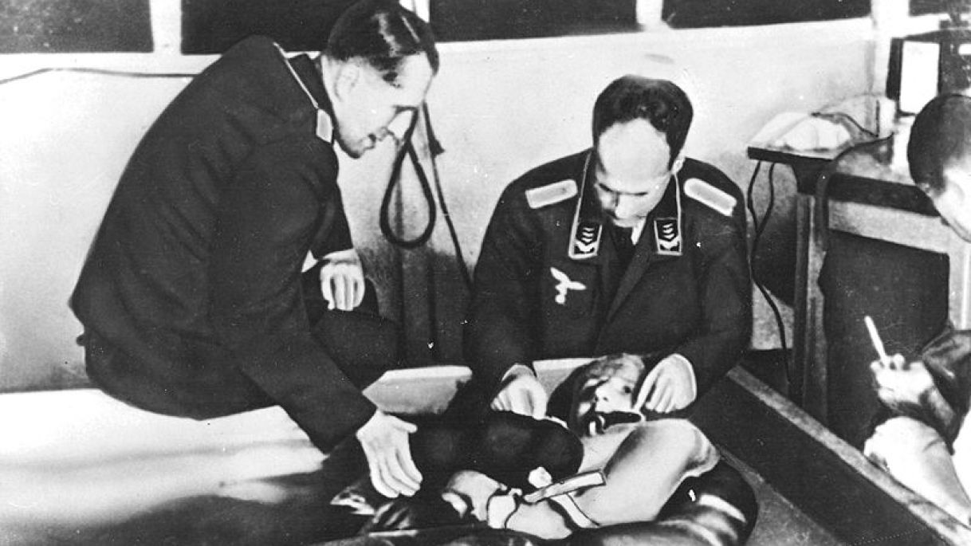
Nazi Human Experiments

Slide 5
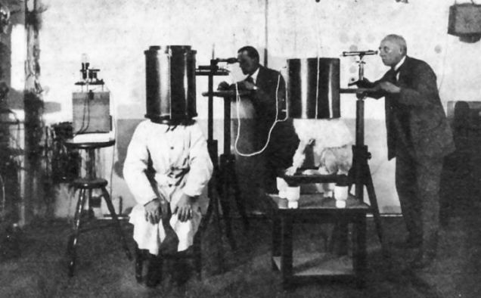
Nazi Human Experiments

Slide 6
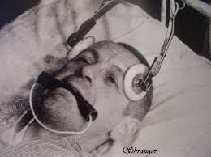
Nazi Human Experiments

Slide 7
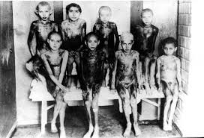
Nazi Human Experiments

Slide 8
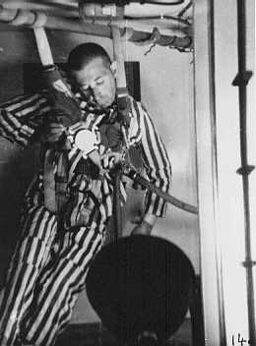
Nazi Human Experiments

Slide 9
Nuremberg Trials
Nuremberg, Germany, was chosen as a site for trials that took place in 1945 and 1946.
Judges from the Allied powers (USA, UK, SU, and France) presided over the hearings of 21 major Nazi criminals.
12 prominent Nazis were sentenced to death.

Slide 10
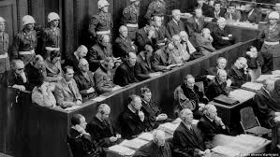
Nuremberg Trials

Slide 11

Nuremberg Trials

Slide 12

World Medical Association Declaration of Helsinki Members are typically represented by National Associations of Physicians from different countries in the world

Slide 13
Ethical Principles for Medical Research Involving Human Subjects
Adopted by the 18th WMA General Assembly, Helsinki, Finland, June 1964, and amended by the:
29th WMA General Assembly, Tokyo, Japan, October 1975
35th WMA General Assembly, Venice, Italy, October 1983
41st WMA General Assembly, Hong Kong, September 1989
48th WMA General Assembly, Somerset West, Republic of South Africa, October 1996
52nd WMA General Assembly, Edinburgh, Scotland, October 2000
53rd WMA General Assembly, Washington, USA, October 2002
55th WMA General Assembly, Tokyo, Japan, October 2004
59th WMA General Assembly, Seoul, South Korea, October 2008
64th WMA General Assembly, Fortaleza, Brazil October 2013

Slide 14
Declaration of Helsinki 2013
1-2
Preamble
3-15
General Principles
16-18
Risks, Burdens, and Benefits
19-20
Vulnerable Groups and Individuals
21-22
Scientific Requirements and Research Protocols
23
Research Ethics Committees
24
Privacy and Confidentiality
25-32
Informed Consent
33
Use of Placebo
34
Post-Trial Provisions
35-36
Research Registration and Publication and Dissemination of Results
37
Unproven Interventions in Clinical Practice

Slide 15
Declaration of Helsinki 2013
Preamble #1
Ethical principles for medical research involving
Human subjects
Identifiable human material and data

Slide 16
Declaration of Helsinki 2013
General Principals #3
The health of my patient will be my first consideration.

Slide 17
Declaration of Helsinki 2013
General Principals #8
The primary purpose of medical research is to generate new knowledge.
This goal can never take precedence over the rights and interests of individual research subjects.

Slide 18
Declaration of Helsinki 2013
General Principals #9
It is the duty of physicians to protect the research subjects’
Life
Health
Dignity
Right to self-determination
Confidentiality
Privacy

Slide 19
Declaration of Helsinki 2013
General Principals #10
Physicians must consider:
Declaration items
Ethical norms
National laws and regulations
International norms and standards

Slide 20
Declaration of Helsinki 2013
General Principals #11
Medical research should be conducted in a manner that minimizes possible harm to the environment.
Radioactive material
Infectious substances
Heavy metals

Slide 21
Declaration of Helsinki 2013
General Principals #12
Medical research involving human subjects must be conducted only by individuals with
appropriate ethics and scientific education, training and qualifications

Slide 22
Declaration of Helsinki 2013
General Principals #15
Appropriate compensation and treatment for subjects who are harmed as a results of participating in research must be ensured.

Slide 23
Declaration of Helsinki 2013
Risks, Burdens, and Benefits #16
Medical research involving human subjects may only be conducted if potential benefits outweigh the risks and burdens

Slide 24
Declaration of Helsinki 2013
Risks, Burdens, and Benefits #17
The risks must be continuously monitored, assessed and documented by the researcher.
Secondary outcomes

Slide 25
Declaration of Helsinki 2013
Vulnerable Groups and Individuals #19
All vulnerable groups and individuals should receive specifically considered protection.
Children
Elderly
Pregnant women
Mentally retarded subjects

Slide 26
Declaration of Helsinki 2013
Vulnerable Groups and Individuals #20
Medical research with a vulnerable group is only justified if the research is responsive to the health or priority of this group.

Slide 27
Declaration of Helsinki 2013
Scientific Requirements and Research Protocols #21
The welfare of animals used for research must be respected.
Sacrifice without pain
Non-harassment sampling

Slide 28
Declaration of Helsinki 2013
Scientific Requirements and Research Protocols #22
The design and performance of each research study involving human subjects must be clearly described and justified in a research protocol.

Slide 29
Declaration of Helsinki 2013
Research Ethics Committees #23
The research protocol must be submitted to the committee for:
Consideration
Comment
Guidance
Approval
before the study begins
No amendment to the protocol may be made without consideration and approval by the committee.

Slide 30
Declaration of Helsinki 2013
Privacy and Confidentiality #24
Every precaution must be taken to protect
The confidentiality of their personal information
The privacy of research subjects

Slide 31
Declaration of Helsinki 2013
Informed Consent #25
The consent must be
Informed
Freely-given
Right to refuse to participate
Right to withdraw at any time without reprisal

Slide 32
Declaration of Helsinki 2013
Informed Consent #26
Each potential subject must be adequately informed of the
Aims
Methods
Anticipated benefits
Potential risks
Institutional affiliations of researcher
Sources of funding
Any possible conflicts of interest

Slide 33
Declaration of Helsinki 2013
Informed Consent #26
Preferably in writing
If the consent cannot be expressed in writing, the non-written consent must be formally documented and witnessed.

Slide 34
Declaration of Helsinki 2013
Informed Consent #28
For a potential research subject who is incapable of giving informed consent
Children
Unconscious patients
Mentally retarded subjects
Prisoners
The physician must seek informed consent from the legally authorized representative.
The potential subject’s dissent should be respected.

Slide 35
Declaration of Helsinki 2013
Informed Consent #32
For medical research using identifiable human
Material
Data
Physician must seek informed consent for
Collection
Storage
Reuse
If impossible or impractical
Research may be done only after consideration and approval of a research ethics committee

Slide 36
Declaration of Helsinki 2013
Informed Consent
Explicit (written) consent
Interventional studies
Implicit (verbal) consent
When written consent is impossible

Slide 37
Declaration of Helsinki 2013
Use of Placebo #34
The benefits, risks, burden and effectiveness of a new intervention must be tested against those of the best proven interventions, except:
No proven intervention exists
The use of placebo is acceptable
The patients must not subject to serious or irreversible harm

Slide 38
Declaration of Helsinki 2013
Research Registration and Publication and Dissemination of Results #35
Every clinical trial must be registered
In a publicly accessible database
Before recruitment of the first subject
ICD-10 code

Slide 39

No. | ANZCTR | Australian New Zealand Clinical Trials Registry
1 | ReBec | Brazilian Clinical Trials Registry
2 | ChiCTR | Chinese Clinical Trial Registry
3 | CRiS | Clinical Research Information Service (Korea)
4 | CTR-I | Clinical Trials Registry - India ()
5 | RPCEC | Cuban Public Registry of Clinical Trials
6 | EU-CTR | EU Clinical Trials Register
7 | DRKS | German Clinical Trials Register
8 | IRCT | Iranian Registry of Clinical Trials
9 | ISRCTN | International Standard Randomized Controlled Trials Number (UK)
10 | JPRN | Japan Primary Registries Network
11 | NTR | Netherlands National Trial Register
12 | PACTR | Pan African Clinical Trial Registry
13 | REPEC | Peruvian Clinical Trial Registry
14 | SLCTR | Sri Lanka Clinical Trials Registry
15 | TCTR | Thai Clinical Trials Registry

Slide 40
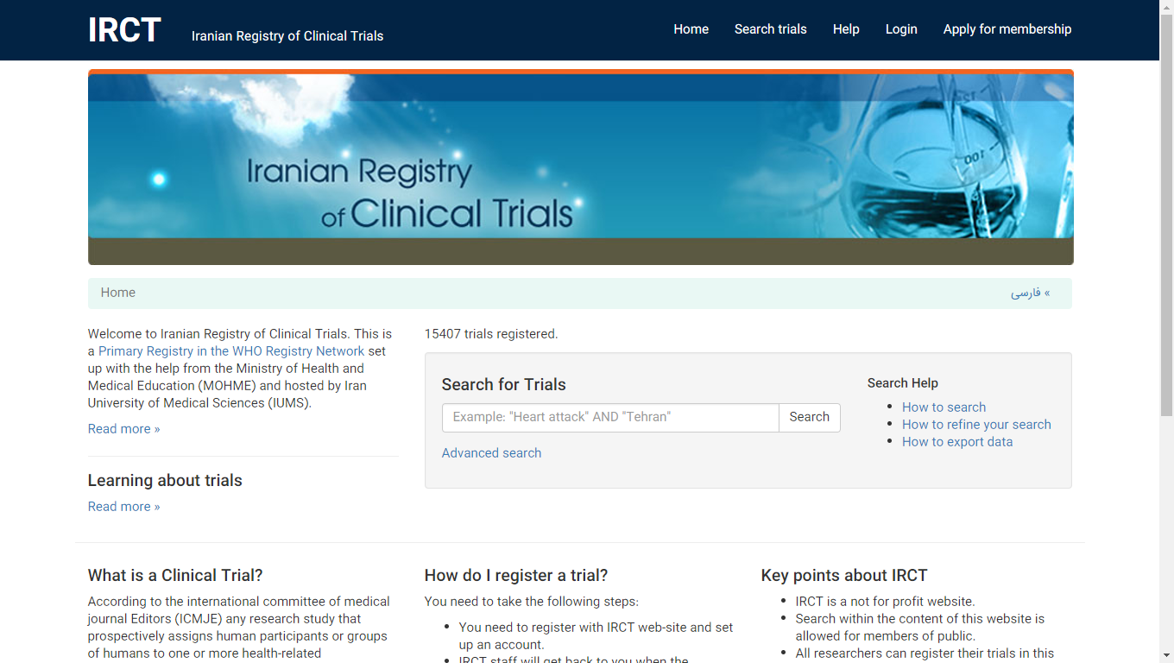

Slide 41
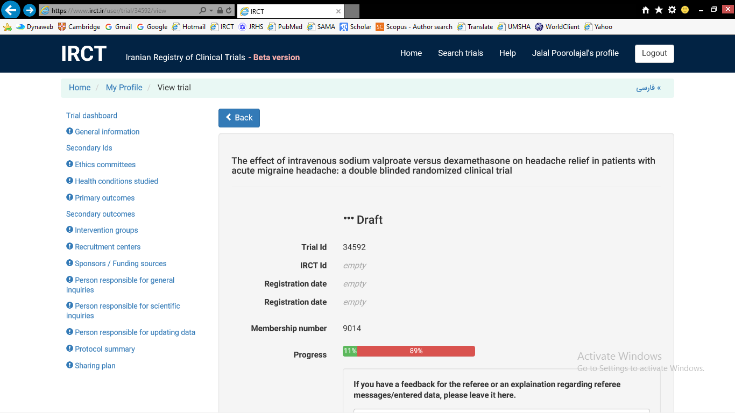

Slide 42
Declaration of Helsinki 2013
Research Registration and Publication and Dissemination of Results #36
Results of must be publicly available
Negative and positive results must be published
Sources of funding and conflicts of interest must be declared
Reports of research NOT in accordance with the principles of this Declaration should NOT be accepted for publication.

Slide 43
Thank you

